Slide 1
Perfect Verbs
Past, present, future…

Slide 2
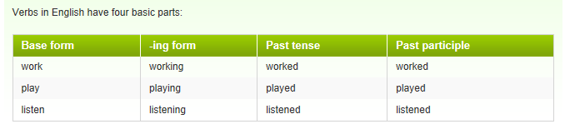
Verbs… basic parts

Slide 3
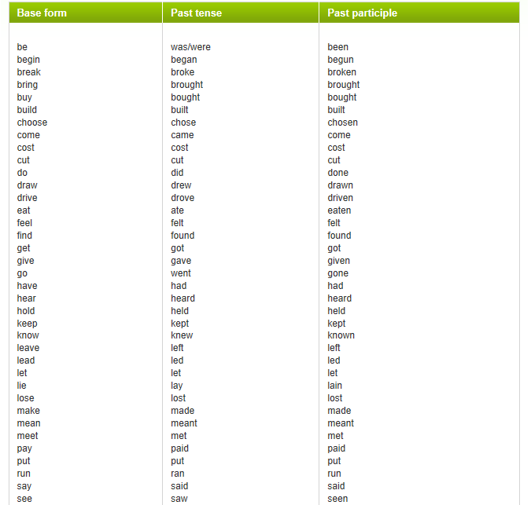

Slide 4
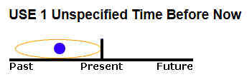
Present perfect
We use the Present Perfect to say that an action happened at an unspecified time before now.
The exact time is not important.
You CANNOT use the Present Perfect with specific time expressions such as: yesterday, one year ago, last week, when I was a child, when I lived in Japan, at that moment, that day, one day, etc.
We CAN use the Present Perfect with unspecific expressions such as: ever, never, once, many times, several times, before, so far, already, yet, etc.
Examples:
I have seen that movie twenty times.
I think I have met him once before.

Slide 5
7.1
Tom has lost his key.
Lisa has broken her leg.
The bus fare has gone up.
Her English has improved.
Dan has grown a beard.
The letter has arrived.
The temperature has fallen.

Slide 6
7.2
He’s gone to Italy.
I’ve just been to the shops.
She’s gone to the shop to get a newspaper.
Tom has gone out.
No, I’ve already been to the bank.

Slide 7
7.3
No thanks. I’ve just had lunch.
Yes, I’ve just seen her.
He’s already left.
I haven’t read it yet.
No, she has already seen the film.
Yes, they have just arrived.
We haven’t told him yet.

Slide 8
7.4
After lunch you got see a friend at her house. She says, ‘Would you like something to eat?’
You say: No thank you. I’ve just had lunch.
I’m afraid he’s just gone out.
I haven’t finished yet.
I’ve already done it.
Have you found a place yet?
I haven’t decided yet.
No, she’s just come back.

Slide 9
Experience
You can use the Present Perfect to describe your experience.
It is like saying, "I have the experience of..."
You can also use this tense to say that you have never had a certain experience.
The Present Perfect is NOT used to describe a specific event.
Examples:
I have been to France.
This sentence means that you have had the experience of being in France. Maybe you have been there once, or several times.
I have been to France three times.
You can add the number of times at the end of the sentence.
I have never been to France.
This sentence means that you have not had the experience of going to France.

Slide 10
Exercise
Write 3 true statements about yourself.
What have you done in your life?
What have you done already (i.e. before coming to class)?
What have you never done?

Slide 11
Write 3 things about yourself – use present perfect.
I have…
I have never…
Make 2 true, and 1 false.

Slide 12
Change Over Time
We often use the Present Perfect to talk about change that has happened over a period of time.
Examples:
You have grown since the last time I saw you.
The government has become more interested in arts education.
Japanese has become one of the most popular courses at the university since the Asian studies program was established.
My English has really improved since I moved to Australia.

Slide 13
Accomplishments
We often use the Present Perfect to list the accomplishments of individuals and humanity. You cannot mention a specific time.
Examples:
Man has walked on the Moon.
Our son has learned how to read.
Doctors have cured many deadly diseases.
Scientists have split the atom.

Slide 14
An Uncompleted Action You Are Expecting
We often use the Present Perfect to say that an action which we expected has not happened. Using the Present Perfect suggests that we are still waiting for the action to happen.
Examples:
James has not finished his homework yet.
Susan hasn't mastered Japanese, but she can communicate.
Bill has still not arrived.
The rain hasn't stopped.

Slide 15
Multiple Actions at Different Times
We also use the Present Perfect to talk about several different actions which have occurred in the past at different times. Present Perfect suggests the process is not complete and more actions are possible.
Examples:
The army has attacked that city five times.
I have had four quizzes and five tests so far this semester.
We have had many major problems while working on this project.
She has talked to several specialists about her problem, but nobody knows why she is sick.

Slide 16

Duration From the Past Until Now (Non-Continuous Verbs)
With non-continuous verbs, we use the Present Perfect to show that something started in the past and has continued up until now.
"For five minutes," "for two weeks," and "since Tuesday" are all durations which can be used with the Present Perfect.
Examples:
I have had a cold for two weeks.
She has been in England for six months.
Mary has loved chocolate since she was a little girl.
Although the above use of Present Perfect is normally limited to Non-Continuous Verbs and non-continuous uses of Mixed Verbs, the words "live," "work," "teach," and "study" are sometimes used in this way even though they are NOT Non-Continuous Verbs.

Slide 17
Present Perfect
I read the book.
I have read the book.
You watch the film.
You have watched the film.
They had breakfast already.
They have already had breakfast.
He goes to school.
He has gone to school.
She waits for a letter to arrive.
She has waited for a letter to arrive.
Come up with your own examples:
1) We have been in the UK since last year.
2) They have seen the Queen.
3) She has played football.

Slide 18
ADVERB PLACEMENT
The examples below show the placement for grammar adverbs such as: always, only, never, ever, still, just, etc.
Examples:
You have only seen that movie one time.
Have you only seen that movie one time?
ACTIVE / PASSIVE
Examples:
Many tourists have visited that castle. Active
That castle has been visited by many tourists. Passive

Slide 19
Present perfect
The present perfect is formed from the present tense of the verb have and the past participle of a verb:
The present perfect continuous is formed with have/has been and the -ing form of the verb:
We use the present perfect tense:
For something that started in the past and continues in the present:
They’ve been married for nearly fifty years. She has lived in Liverpool all her life.
We normally use the present perfect continuous for this:
She has been living in Liverpool all her life. It’s been raining for hours.
For something we have done several times in the past and continue to do:
I’ve played the guitar ever since I was a teenager. He has written three books and he is working on another one. I’ve been watching that programme every week.

Slide 20
We often use a clause with since to show when something started in the past:
They’ve been staying with us since last week.
I have worked here since I left school.
I’ve been watching that programme every week since it started.
When we are talking about our experience up to the present:
We often use the adverb ever to talk about experience up to the present:
My last birthday was the worst day I have ever had.
And we use ‘never’ for the negative form:
Have you ever met George? Yes, but I’ve never met his wife.
For something that happened in the past but is important at the time of speaking:
I can’t get in the house. I’ve lost my keys. Teresa isn’t at home. I think she has gone shopping. I’m tired out. I’ve been working all day.

Slide 21
We use the present perfect of be when someone has gone to a place and returned:
A: Where have you been? B: I’ve just been out to the supermarket.
A: Have you ever been to San Francisco? B: No, but I’ve been to Los Angeles.
But when someone has not returned we use have/has gone:
A: Where is Maria? I haven’t seen her for weeks. B: She's gone to Paris for a week. She’ll be back tomorrow.
We often use the present perfect with time adverbials which refer to the recent past:
just; only just; recently;
Scientists have recently discovered a new breed of monkey. We have just got back from our holidays.
or adverbials which include the present:
ever (in questions); so far; until now; up to now; yet (in questions and negatives)
Have you ever seen a ghost? Where have you been up to now? Have you finished your homework yet? No, so far I’ve only done my history.

Slide 22
WARNING:
We do not use the present perfect with an adverbial which refers to past time which is finished:
I have seen that film yesterday. We have just bought a new car last week.
When we were children we have been to California.
But we can use it to refer to a time which is not yet finished:
Have you seen Helen today?
We have bought a new car this week.

Slide 23
Past perfect
When we talk about something that happened in the past we sometimes want to refer back to something that happened before that time. We can use the past perfect tense (had + past participle) to do this.
Look at these two sentences.
John left the house at 7:30 yesterday morning.
Mary rang John’s doorbell at 8:15 yesterday.
Both actions happened in the past so we use the past simple tense. But look at how we can combine the sentences.
Mary rang John’s doorbell at 8:15 yesterday but John had already left the house.

Slide 24
We use the past perfect (had left) because the action happened before another action in the past (Mary rang the doorbell.)
Look at some more examples of the past perfect.
When Mrs Brown opened the washing machine she realised she had washed the cat.
I got a letter from Jim last week. We’d been at school together but we’d lost touch with each other.
The past perfect is used because they were at school before he received the letter. It refers to an earlier past.
Look at these 2 sentences.
James had cooked breakfast when we got up.
James cooked breakfast when we got up.
In the first sentence, the past perfect tells us that James cooked breakfast before we got up. In the second sentence, first we got up and then James cooked breakfast.

Slide 25
Past perfect continuous
Past perfect continuous
The past perfect can also be used in the continuous. I realised I had been working too hard so I decided to have a holiday.
By the time Jane arrived we had been waiting for 3 hours.
NOTE The most common mistake with the past perfect is to overuse it or to use it simply because we are talking about a time in the distant past.
The Romans had spoken Latin.
Remember that we only use the past perfect when we want to refer to a past that is earlier than another time in the narrative.

Slide 26
Future perfect
Future Perfect has two different forms:
"will have done" and "be going to have done.“
FORM Future Perfect with "Be Going To"
[am/is/are + going to have + past participle]
Examples:
You are going to have perfected your English by the time you come back from the U.S.
Are you going to have perfected your English by the time you come back from the U.S.?
You are not going to have perfected your English by the time you come back from the U.S.
NOTE: It is possible to use either "will" or "be going to" to create the Future Perfect with little or no difference in meaning.

Slide 27

Completed Action Before Something in the Future
The Future Perfect expresses the idea that something will occur before another action in the future. It can also show that something will happen before a specific time in the future.
Examples:
By next November, I will have received my promotion.
By the time he gets home, she is going to have cleaned the entire house.
I am not going to have finished this test by 3 o'clock.
Will she have learned enough Chinese to communicate before she moves to Beijing?
Sam is probably going to have completed the proposal by the time he leaves this afternoon.
By the time I finish this course, I will have taken ten tests.
How many countries are you going to have visited by the time you turn 50?
Notice in the examples above that the reference points (marked in italics) are in Simple Present rather than Simple Future.
This is because the interruptions are in time clauses, and you cannot use future tenses in time clauses.

Slide 28
Duration Before Something in the Future (Non-Continuous Verbs)
With Non-Continuous Verbs, we use the Future Perfect to show that something will continue up until another action in the future.
Examples:
I will have been in London for six months by the time I leave.
By Monday, Susan is going to have had my book for a week.
Although the above use of Future Perfect is normally limited to Non-Continuous Verbs and non-continuous uses of Mixed Verbs, the words "live," "work," "teach," and "study" are sometimes used in this way even though they are NOT Non-Continuous Verbs.
REMEMBER No Future in Time Clauses
Like all future forms, the Future Perfect cannot be used in clauses beginning with time expressions such as: when, while, before, after, by the time, as soon as, if, unless, etc. Instead of Future Perfect, Present Perfect is used.
Examples:
I am going to see a movie when I will have finished my homework. Not Correct
I am going to see a movie when I have finished my homework. Correct

